Slide 1
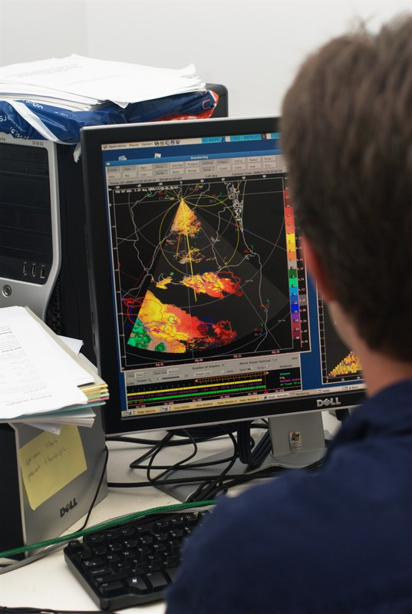
Welcome to the 1st Open source radar short course

Slide 2
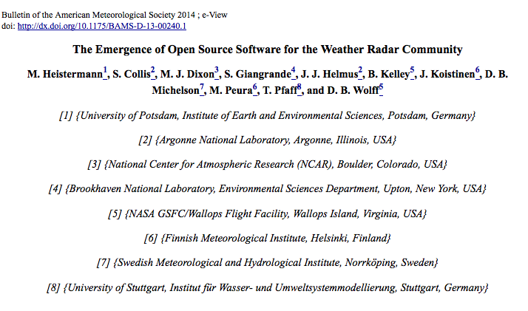
About the course
1st ever of its kind!
Collaboration between EU and USA (Aussie!)
Multi-agency
Spawned from a collaborative BAMS article on the state of open source software in active remote sensing
The aim is to equip attendees with an array of open source tools to interact with a variety of radar data.

Slide 3

WHY BOTHER?
Open source software is both self sustaining and self destroying.
The ability to “fork” a package, start a new development path, allows good ideas to surface and survive naturally. We can not hide our bad code, but people can make it better!
Agencies, governments and private enterprise is seeing the value of open source and even committing resources to OSS packages (Scientific Python a key example).
We love it when you tell us problems with our code. We love it more when you help us make it better!

Slide 4
Course Outline
Introduction of tutors and course outline, brief participant survey.
Technology setup: Launching the Virtual Machine for the course via VirtualBox.
Version control and community coding, users as co-developers at the heart of OSS.
The Python language
IPython an the IPython notebook.
Coffee

Slide 5
Course Outline (2)
IPython and the IPython notebook
Hands on with the Python ARM Radar Toolkit
Hands on with wradlib
Lunch (provided)
Hands on wradlib (cont)
Hands on Baltrad
Coffee
Interoperability: Using all the packages together!
Feedback

Slide 6

Your instructors: BALTRAD
Daniel Michelson
Swedish Meteorological and
Hydrological Institute Chair BALTRAD Group
Anders Henja
Henjab, AB
BALTRAD Chief Architect

Slide 7

Your instructors: wradlib
Maik Heistermann University of Potsdam, Germany wradlib developer Thomas Pfaff Blue Yonder, Germany wradlib developer Kai Muehlbauer University of Bonn, Germany wradlib developer

Slide 8


Your instructors: Py-ART
Scott Collis
Argonne National Laboratory
ARM Radar Translator
Science Lead Py-ART
Jonathan Helmus
Argonne National Laboratory
ARM Developer
Development lead Py-ART

Slide 9
Survey
Please go to:
https://www.surveymonkey.com/s/Y3SGVV2

